Slide 1
An Investigation of Wearables, Illness and Recovery
Notes:
Hi I am Mark Drummond
My Capstone was an investigation into wearables, illness and recovery

Slide 2
Background
Current Study
The study was started by a physical therapist named Mike Eisenhart called PT Health Study
They wanted a way of using existing wearables to detect, interpret and minimize the impact of acute distress / illness
Current population is 28,000 individuals made up mainly PT’s and their patients.
Lasted for little over a year
Provide a dashboard for the clinician and their patients
The person is contacted when their metrics go outside their limits
Only reactive not yet proactive
Current Findings
Ability to identify when someone is getting sick, had and injury or is under long periods of stress
Earlier in the study they were able to identify that a patient contracted Covid-19 days before they showed symptoms
Notes:
Some background
I got involved with a study that collected data from Garmin fitness tracking watches.
Study population was mostly Physical Therapist and their patients.
Population was a little over 28,000 individuals and lasted for a year
The raw data from Garmin tracked things like heart rate , blood oxygen, saturation levels, sleep and stress scores.
The data collected was captured and presented on a dashboard that health care clinicians can see and use to monitor their patients and patient populations.
During the study they were able to identify some people who had contracted COVID-19 before they displayed any symptoms
But, this is a very manual process and not always accurate, repeatable , or timely

Slide 3
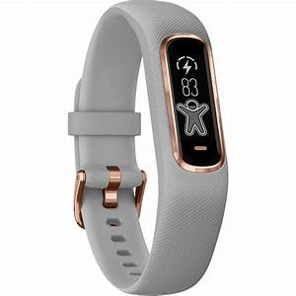
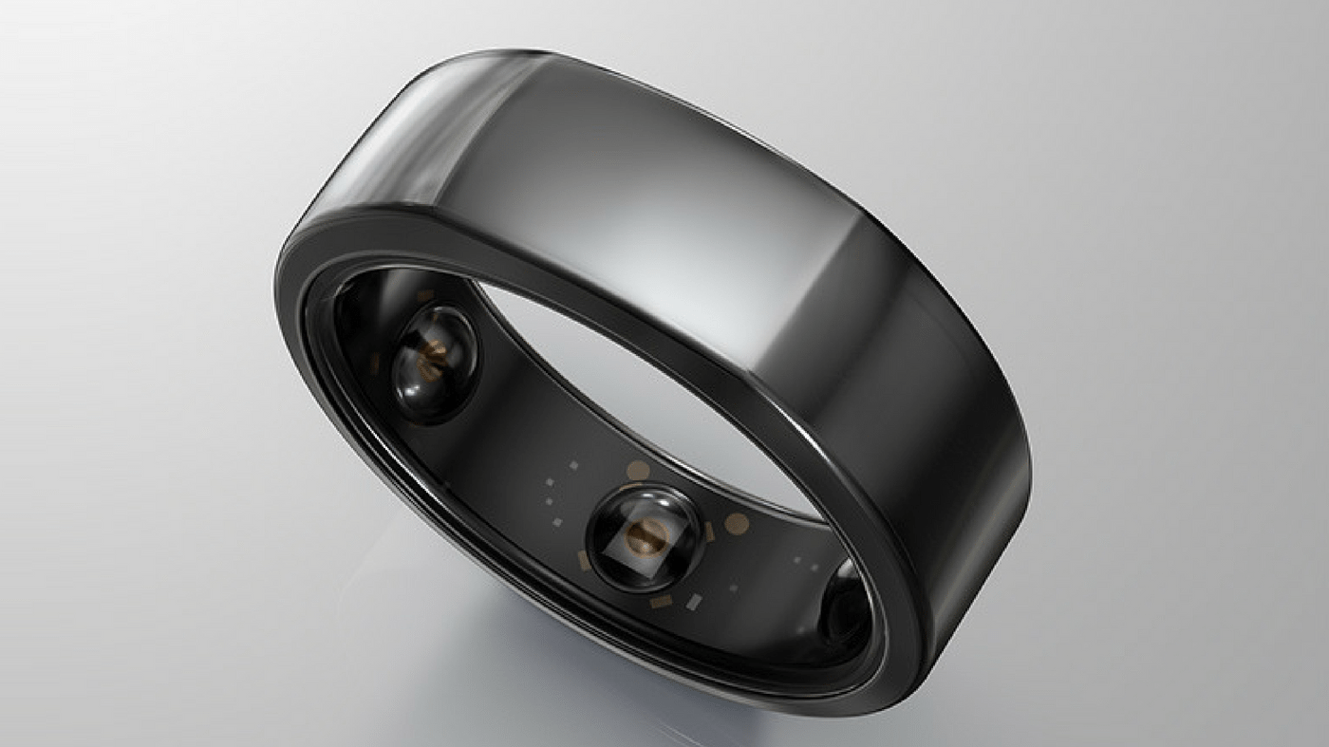
Examples of Wearable Devices
Devices
Garmin - VivoSmart4 Oura Ring
Notes:
These are examples of two of the many Wearable device available on the market.
The Garmin Vivo Smart4 was the preferred device used in the study.
The Oura ring was used by some NBA players in the bubble to monitor their health.
The Oura ring monitors Activity Level, Sleep, Heart Rate Variability, Respiratory Rate and Temperature.
I personally use the orua ring and a Garmin Fenix 5.

Slide 4
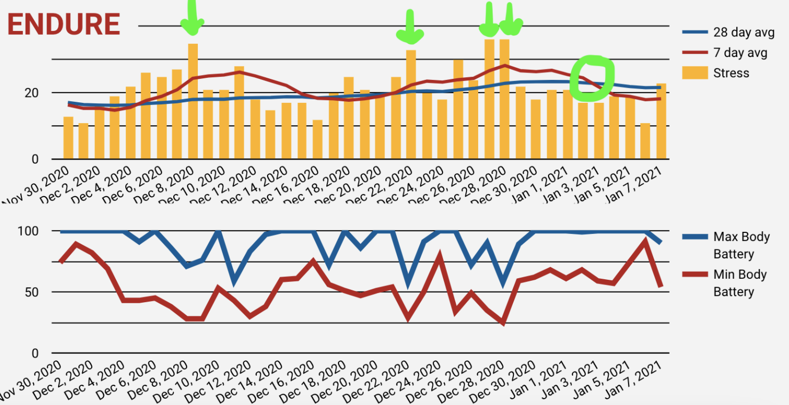
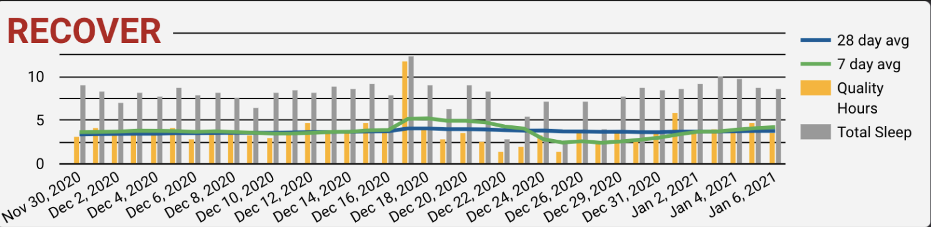
Dashboard example
Patient example
Dec 9th. Daughter tested positive, Patient Tested negative for COVID
No symptoms until December 16th . – Tested Positive on December 18th ( small spike in stress)
Illness progressed, with server symptoms requiring steroids, and two ER visits. December 25-27
Difficulty breathing
High resting HR (90’s – 150)
Significant chest pain and bilateral arm and hand pain
Noticed low Body Battery measurements as well
December 8-12 (likely from initial infection)
December 22-29 (likely intense immune response “cytokine storm”)
Notes:
This is an example of the one of the study dashboards.
In this example On December 8th We see where the user’s 7 day average HRV went outside 2 standard deviation from their 28 day moving average.
Along with their Stress score spiking
This lines up with when the patient was infected with COVID-19. But did not present with any symptoms for another 5 days.
Their HRV and stress score spiked again on Dec 22, 28-29th as a result of a severe immune reaction (cytokines storm)
In the middle graph you can see where the patient body battery drops around the same time as the spikes.

Slide 5
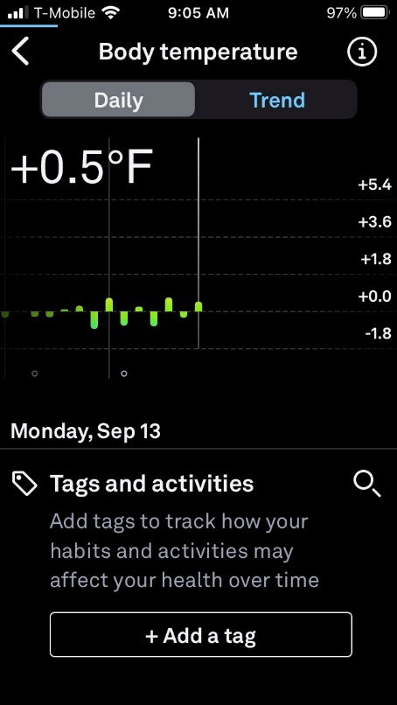
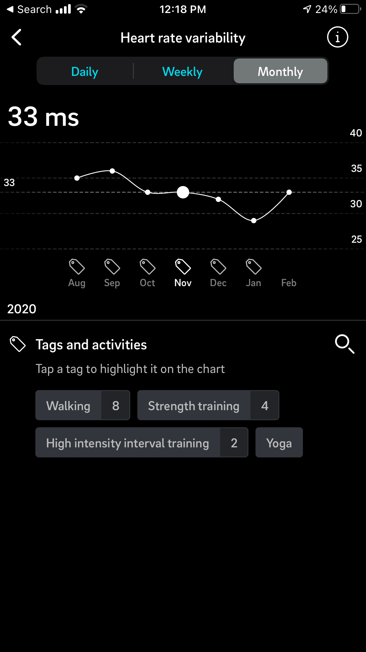
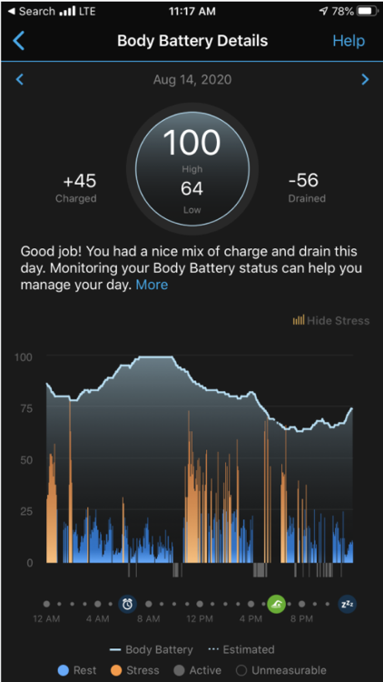
Oura Examples
Oura app
Notes:
This is an example of some of the data available from the Oura app.
The Oura ring is great for seeing changes in body temperature which is not available from the Garmin used in the study.
Temperature from the Oura ring was used by the same patient to identify when they caught COVID a second time. This was after having both COVID and the Vaccine.

Slide 6
Metrics
Metrics
HPV – Heart Rate Variability is the Variance between heartbeats in milliseconds (Mean Square root)
Higher the better
Low indicates your body is working hard for some reason
Function of your autonomic nervous system - parasympathetic (deactivating) and sympathetic (activating).
Stress level – Calculated Using HRV
Body Battery – Calculated using Heart Rate Variability, Stress, and activity to estimate a user’s energy reserves throughout the day.
Normalized to 1-100
Represents the individuals energy level.
Will change over the day but should be highest in the morning after sleep and get lower as the user completes tasks and activities.
Based on the individual 7 day and 30-day rolling average
Limits are 2 standard deviations
Notes:
Some of the most promising metrics were
Heart Rate Variability – The more Variability the better shape you are in
Stress Level – This indicates how much stress is your body having to deal with.
Body Battery - How much energy do you have.

Slide 7
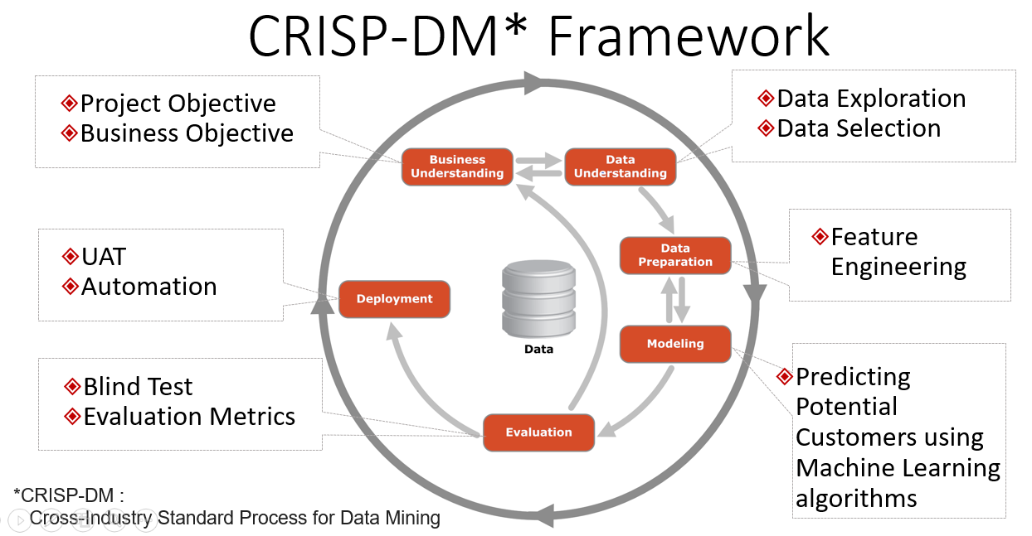
CRISP- DM Framework
Using CRISP-DM framework
Business Understanding
Data Understanding
Data Preparation
Modeling
Evaluation
Notes:
For the project I used the CRISP-DM framework
Business Understanding
Data Understanding
Data Preparation
Modeling
Evaluation
All of these you will learn as part of the Fairfield U MSBA program.

Slide 8
Problem Framing
Problem Statement
This project was to research and identify correlations between different metrics available with off the shelf wearables and develop an algorithm that can predict onset of moving from one state to another. Multiclass Classification problem.
Possible States
Better
Same
Stressed
Unwell (Injured, ill, chronic, distress)
Notes:
In this project we wanted to identify any correlation between a patients status and metrics available from passive wearables
So that they could identify what state the person was in and where they were heading.
We focused on 4 possible states of wellness
- Better, Same, Stressed, and Unwell
If we can predict that, then the clinician can then provide better protocols for their patients
This projects goal was to create a multiclass classification model that could be used to by clinicians to predict their patients status.

Slide 9
Business Understanding
Business Understanding
Worked with my SME, Nick Pfaff to understand what questions they were trying to answer.
Wanted two things
Validation of what they were seeing and interpreting on the dashboard
Method to predict where the patient was headed (same, better, stress, injury)
Also worked with my other SME, Jessica Drummond who is was looking at recovery and wanted a way to predict when a patient was in a recovery phase.
The end goal for both is to be able to customize plans to better help the individual patient.
Notes:
During Business Understanding
I meet with my SME’s and discussed the project. They wanted 2 things.
Validation that it was possible to predict when someone was getting sick.
Originally this was at the beginning of the pandemic when there was not a vaccine and it was unclear exackly how or why people were getting sick. We were bleaching everthing.
Automated method to predict where a patient was or heading to
The end goal being to provide better patient care

Slide 10
Data Understanding
Original data sets
Data Set | Source | Size
Activity Records | BigQuery | (200686, 20)
Body Battery | BigQuery | (138099, 10)
Metrics | BigQuery | (34337, 6)
Sleep | BigQuery | (401485, 10)
Registration | SpreadSheet | (497, 12)
Baseline | SpreadSheet | (282, 101)
Survey Result | SpreadSheet | (6148, 98)
Notes:
I started out with 7 different data sets
The data came from 2 sources
were from a Google BigQuery database
3 were Excel spreadsheets given to me by the SME
After initial Exploratory Data Analysis, I dropped the registration dataset because there was no real predictive features and it contained mostly missing data

Slide 11
Data Preparation
Removed Duplicate Records
Activity
Body Battery
Metrics
Sleep Records
Registration
Survey
Expanded 2 columns in the Activity Records
Heart rate - {'minimum' 'maximum', 'resting’}
Stress Rate - {'average', 'qualifier', 'duration'{'rest': 'activity':, 'low':, 'medium':, 'high': }}
Merge the data sets together
Clean Up the Merged data set
Changed column data types
Changed the ‘date’ data type from object to datetime
Changed Object data types to integer
Dropped rows and columns
Drop rows with a dates not in date rage of Weekly Survey data (5/13/2020 – 4/6/2021)
Drop rows with 'stress_avg' rows with 'None’
Drop unused column (Client ID)
Drop Columns with a High Missing Rate
Imputing Missing values
Added survey date as next Tuesday. Will be used to merge with prediction data set
Notes:
Since the data I receive was vey raw
I had to do a far amount of clean up and prep work so that I could create a data set I could feed into the models
You will find this to be true with most data sets you will have to work with.
Some of what I did was to
Removed duplicates
Expanded columns that contained columns
Created a single dataset
Drops unpredictive columns
Imputed missing values

Slide 12
Data Preparation cont.
Add Additional Predictors
7-day Stress score moving average
28-day Stress score moving average
28-day Stress score STD Deviation
7 Day Stress Score Moving Average within 28-day SSMA + 0 to 1 STD DEV
7 Day Stress Score Moving Average within 28-day SSMA + 1 to 2 STD DEV
7 Day Stress Score Moving Average within 28-day SSMA + 2 to 3 STD DEV
7 Day Stress Score Moving Average within 28-day SSMA + > 3 STD DEV
Number of STD Deviation 7 Day Stress score id from 28-day SSA
One Hot Encode last 5 predictors
Create and Clean Prediction Data set
Add prediction column (Status)
Add 'survey_date'
Remove Duplicate records
Notes:
Once I have the combined dataset I :
Add additional derived features based on feedback from the SME’s.
Better know as Feature Engineering
Mainly the 7 day and 28 day moving average metrics

Slide 13
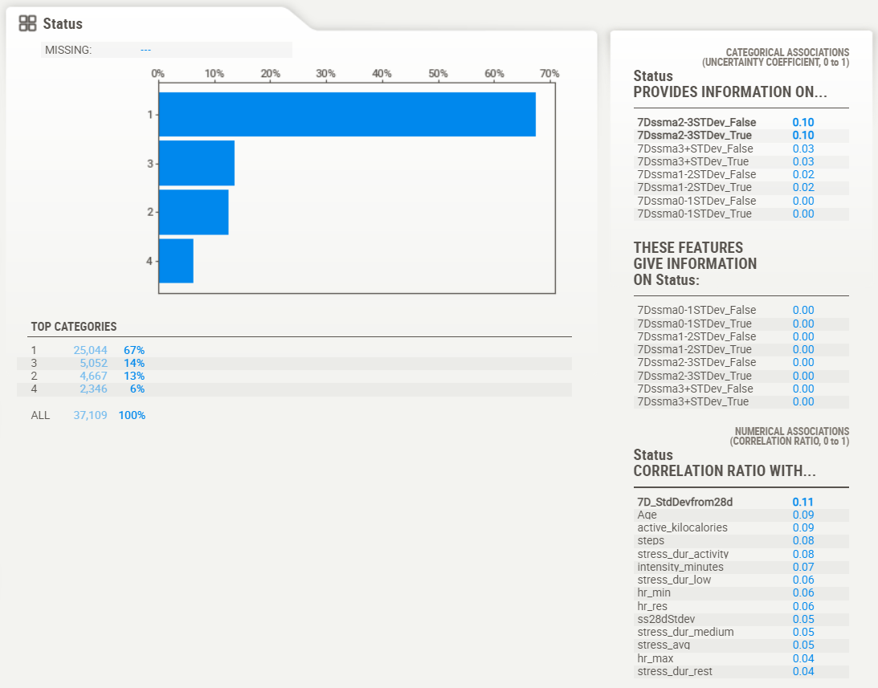
Data Understanding Merged data set
EDA on clean dataset and verification ready for model selection
No NaN’ Nulls, or missing
37,109 rows and 33 features
The prediction “Status” highly unbalances towards “Same” value with 67%
Status | Code
Same | 1
Better | 2
Stress | 3
Unwell | 4
Notes:
Then performed EDA again on the merged dataset.
I ended up with a dataset with
37,109 rows and 33 feature (25 numerical and 9 categorical)
Some skewness
Most notable the Target (Status) is highly unbalanced towards “Same” with 67% of all rows
The Highest correlations with :
HR, Stress and stress scores
The lower correlations with
Sleep and Spo2 (oxygen levels)

Slide 14
Data Understanding Merged data set cont.
Feature Importance score / Categorical Association
Calculated the feature Importance score for all the predictors using the RandomForestClassifier.
SweetViz CATEGORICAL ASSOCIATIONS
Feature | Score
ss28dStdev | 0.06080612
ss28dmavg | 0.057310216
Age | 0.052580477
7D_StdDevfrom28d | 0.050370543
active_kilocalories | 0.049203482
steps | 0.047944173
ss7dmavg | 0.047195941
stress_dur_activity | 0.046872676
stress_dur_low | 0.045176338
stress_dur_rest | 0.044177387
Feature | SWEETViz Categorical Assoc.
7D_StdDevfrom28d | 0.11
active_kilocalories | 0.09
Age | 0.09
stress_dur_activity | 0.08
steps | 0.08
intensity_minutes | 0.07
hr_min | 0.06
hr_res | 0.06
stress_dur_low | 0.06
ss28dStdev | 0.05
Notes:
Additionally I used RamdonForest to identify the most important feature in the data set.
More feature does not necessary mean better models.
I can have multiple variables that predicting the same thing
In other words, one predictor variable can be used to predict the other.
Example - Calories burned and number of steps taken.

Slide 15
Modeling and Evaluation
Balance the Prediction “Status” using Synthetic Minority Oversampling Technique (SMOTE) and TPOT
Best score was Produced by KNeighborsClassifier
Score of 0.7467
Increase of 6% over Non balanced data
Notes:
For Modeling and Evaluation I used TOPT (Tree-based Pipeline Optimization Tool )
TPOT automates the
Feature Selection
Feature preprocessing
Feature construction
Model selection
Hyperparameter Optimization
My initial model had a cross validation score of .6322 using the Decision Tree Classifier.
After I balanced the data set using Synthetic Minority Oversampling Technique (SMOTE ).
I was able to increase result by 6.35% to a score of .7467 using the K Nearest Neighbor Classifier model
Remember 67% of the rows were classified as “Same”. By balancing the data I was able to remove any biases the model towards “Same”

Slide 16
Reporting & Next Steps
What’s Next
Change the question – Predict what phase the a specific user is going to be in next.
Get more data – Original data did not include any individual that was 2 or more STD outside their 28 day HRV range.
Develop into a usable tool – Work to make the model something that can be easily used as a tool by an end user.
Notes:
The next steps are :
Change the question to predict what state the patient is going to be in next.
Are they training too much. Are they recovering from injury, surgery, etc.
Collect more data – The original dataset did not have any records with a 7 day HRV average outside 2 STDV of the 28 day average
Continue to work towards developing an app based on these models

Slide 17
MSBA Skills used
Business Understanding
Used the skills from BUAN 6500 Business Analytics for Problem Framing.
Data Understanding
Used Skills from BUAN 6530 Forecasting and BUAN 6545 - Machine Learning for Predictive Analysis for analyzing the 7 data sets provided - Nulls, NaN’s, Missing, Max, Min, average, Medium, etc.
Data Preparation
Used skills from BUAN 6510 Database to pull data from BigQuery
Used skills from BUAN 6545 to load and manipulate data in Python
Modeling and Evaluation
Used skills from BUAN 6545 to model select the best preforming machine learning model and improve it’s performance.
Notes:
These are just some of the skills I learned in the MSBA program that allowed me to successfully complete this project.
BUAN 6500 – Problem Framing
BUAN 6530, 6545 – Analyzing Data
BUAN 6510, 6545 – Loading and Manipulation Data
BUAN 6545 – Model Selection and Evaluation
- Story Telling
I also using a number of these skills in my internship at Synchrony.

Slide 18
Q&A
Notes:
I want to open it up know for any questions.

Slide 19
Appendix
Reference List
Pyrkov, T.V., Avchaciov, K., Tarkhov, A.E. et al. Longitudinal analysis of blood markers reveals progressive loss of resilience and predicts human lifespan limit. Nat Commun 12, 2765 (2021). https://doi.org/10.1038/s41467-021-23014-1
Smarr, B.L., Aschbacher, K., Fisher, S.M. et al. Feasibility of continuous fever monitoring using wearable devices. Sci Rep 10, 21640 (2020). https://doi.org/10.1038/s41598-020-78355-6

Slide 20
Tools Used
Technologies and tools
Google BigData as a data repository
Python for data manipulation and Scikit-learn for Machine learning
Sweetvis for EDA
TPOT for Model selection

Slide 21
Data Dictionary

Slide 22
Project Rubric for project presentation
Reasonable Problem Framing
Intriguing background and compelling motivation
Unambiguous and interesting problem statement
Appropriate Data Preparation
Clearly identified and described data sources
Contextually motivated data munging (describe the processing or filtering of raw data into another form.)
Informative Exploratory Data Analysis or System Design
Proper visualizations (meaningful colors, non-deceptive axes, intuitive design)
Flow charts for system design
Thoughtful Analytical Modeling or Comprehensive System Walkthrough
Alternatives explored and reasons discarded
Critical model validation or system bugs documentation
Reporting
Specific examples of useful applications or convincing interpretation, plus doable next steps
New skills or lessons learned during capstone

Slide 23
Sweetviz Report

Slide 24



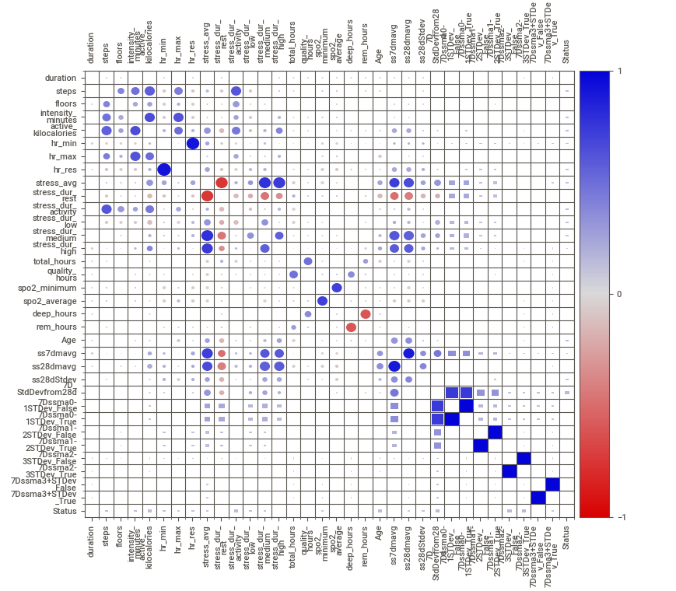

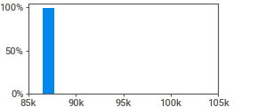
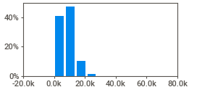
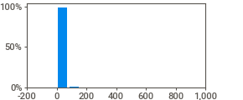
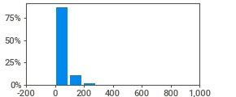
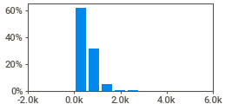
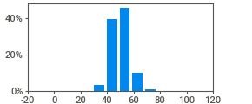
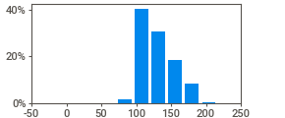

DataFrame
NO COMPARISON TARGET
Associations
[Only including dataset "DataFrame"]
Squares are categorical associations (uncertainty coeﬃcient & correlation ratio) from 0 to 1. The uncertainty coeﬃcient is assymmetrical, (i.e. ROW LABEL values indicate how much they PROVIDE INFORMATION to each LABEL at the TOP).
Circles are the symmetrical numerical correlations (Pearson's) from -1 to 1. The trivial diagonal is intentionally left blank for clarity.
37109 ROWS
2.1.2
Get updates, docs & report issues here
Created & maintained by Francois Bertrand Graphic design by Jean-Francois Hains
0 DUPLICATES
10.4 MB RAM
34 FEATURES
9 CATEGORICAL
ASSOCIATIONS
25 NUMERICAL
0 TEXT
1
duration
VALUES: MISSING:
DISTINCT: ZEROES:
37,109 (100%)
---
12 (<1%)
---
MAX 100,800
RANGE | 14,400
IQR | 0.00
STD | 271
VAR | 73,609
KURT. | 772
SKEW | 24.4
SUM | 3.2B
95% | 86,400
Q3 | 86,400
AVG | 86,414
MEDIAN | 86,400
Q1 | 86,400
5% | 86,400
MIN | 86,400
2
steps
VALUES: MISSING:
DISTINCT: ZEROES:
37,109 (100%)
---
15,139 (41%)
36 (<1%)
MAX
69,576
RANGE | 69,576
IQR | 5,833
STD | 4,625
VAR | 21.4M
95% 16,904
Q3 11,042
AVG 8,521
MEDIAN 7,971
Q1 | 5,209
5% | 2,189
MIN | 0
MAX | 777
95% | 39
Q3 | 14
AVG | 11
MEDIAN | 7
Q1 | 2
5% | 0
MIN | 0
KURT. | 4.26
SKEW | 1.13
SUM | 316.2M
RANGE | 777
IQR | 12.0
STD | 17.5
VAR | 306
KURT. | 178
SKEW | 8.02
SUM | 424k
3
ﬂoors
VALUES: MISSING:
DISTINCT: ZEROES:
37,109 (100%)
---
189 (<1%)
5,481 (15%)
4
intensity_minutes
VALUES: | 37,109 (100%)
MISSING: | ---
DISTINCT: | 450 (1%)
ZEROES: | 19,013 (51%)
MAX | 955
95% | 143
Q3 | 59
AVG | 37
MEDIAN | 0
Q1 | 0
5% | 0
MIN | 0
RANGE | 955
IQR | 59.0
STD | 58.8
VAR | 3,461
KURT. | 21.7
SKEW | 3.29
SUM | 1.4M
5
active_kilocalories
VALUES: MISSING:
DISTINCT: ZEROES:
37,109 (100%)
---
2,163 (6%)
77 (<1%)
MAX | 5,649
95% | 1,223
Q3 | 707
AVG | 534
MEDIAN | 456
Q1 | 251
5% | 88
MIN | 0
RANGE | 5,649
IQR | 456
STD | 412
VAR | 170k
KURT. | 14.7
SKEW | 2.61
SUM | 19.8M
RANGE | 97.0
IQR | 9.00
STD | 6.94
VAR | 48.1
KURT. | 0.339
SKEW | 0.302
SUM | 1.9M
6
hr_min
VALUES: MISSING:
DISTINCT: ZEROES:
37,109 (100%)
---
57 (<1%)
2 (<1%)
MAX | 97.0
95% | 62.0
Q3 | 54.0
MEDIAN | 50.0
AVG | 50.0
Q1 | 45.0
5% | 39.0
7
hr_max
MIN | 0.0
MAX | 240
95% | 174
Q3 | 147
AVG | 130
MEDIAN | 123
Q1 | 113
5% | 102
MIN | 0
MAX | 90.0
95% | 69.0
Q3 | 61.0
MEDIAN | 56.0
AVG | 55.9
Q1 | 51.0
5% | 44.0
MIN | 0.0
VALUES: MISSING:
DISTINCT: ZEROES:
37,109 (100%)
---
154 (<1%)
2 (<1%)
RANGE | 240
IQR | 34.0
STD | 23.0
VAR | 531
KURT. | -0.297
SKEW | 0.674
SUM | 4.8M
RANGE | 90.0
IQR | 10.0
STD | 7.55
VAR | 57.0
KURT. | 0.122
SKEW | 0.191
SUM | 2.1M
8
hr_res
VALUES: MISSING:
DISTINCT: ZEROES:
37,109 (100%)
---
60 (<1%)
2 (<1%)

Slide 25

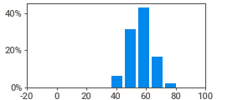
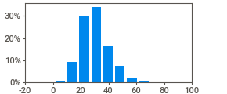
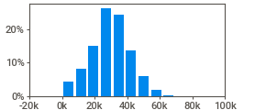
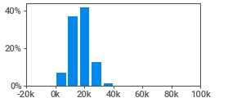
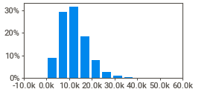
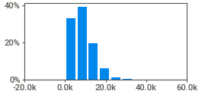
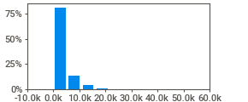
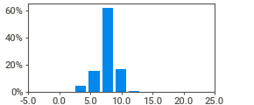
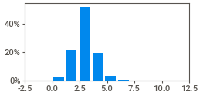

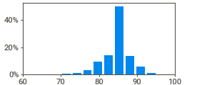
9
stress_avg
VALUES: MISSING:
DISTINCT: ZEROES:
37,109 (100%)
---
83 (<1%)
---
MAX | 87.0
95% | 49.0
Q3 | 36.0
AVG | 30.2
MEDIAN | 29.0
Q1 | 23.0
5% | 16.0
MIN | 1.0
RANGE | 86.0
IQR | 13.0
STD | 9.98
VAR | 99.5
KURT. | 0.876
SKEW | 0.731
SUM | 1.1M
10
stress_dur_rest
VALUES: MISSING: | 37,109 --- | (100%)
DISTINCT: | 1,105 | (3%)
ZEROES: | 50 | (<1%)
MAX | 77,100
95% | 49,440
Q3 | 37,260
MEDIAN | 29,760
AVG | 29,540
Q1 | 22,140
5% | 8,460
MIN | 0
RANGE | 77,100
IQR | 15,120
STD | 11,982
VAR | 143.6M
KURT. | -0.057
SKEW | -0.024
SUM | 1.1B
11
stress_dur_activity
VALUES: MISSING:
DISTINCT: ZEROES:
37,109 (100%)
---
762 (2%)
28 (<1%)
MAX | 81,480
95% | 28,620
Q3 | 21,780
AVG | 17,537
MEDIAN | 17,280
Q1 | 12,960
5% | 7,020
MIN | 0
RANGE | 81,480
IQR | 8,820
STD | 6,797
VAR | 46.2M
KURT. | 1.92
SKEW | 0.462
SUM | 650.8M
12
stress_dur_low
VALUES: MISSING:
DISTINCT: ZEROES:
37,109 (100%)
---
630 (2%)
49 (<1%)
MAX | 48,180
95% | 23,040
Q3 | 15,480
AVG | 12,035
MEDIAN | 11,280
Q1 | 7,740
5% | 3,660
MIN | 0
RANGE | 48,180
IQR | 7,740
STD | 5,993
VAR | 35.9M
KURT. | 1.03
SKEW | 0.794
SUM | 446.6M
13
stress_dur_medium
VALUES: MISSING:
DISTINCT: ZEROES:
37,109 (100%)
---
548 (1%)
73 (<1%)
MAX | 55,860
95% | 18,360
Q3 | 11,700
AVG | 8,604
MEDIAN | 7,680
Q1 | 4,620
5% | 1,740
MIN | 0
RANGE | 55,860
IQR | 7,080
STD | 5,271
VAR | 27.8M
KURT. | 1.55
SKEW | 0.986
SUM | 319.3M
14
stress_dur_high
VALUES: MISSING:
DISTINCT: ZEROES:
37,109 (100%)
---
465 (1%)
652 (2%)
MAX | 53,340
95% | 11,100
Q3 | 4,140
AVG | 3,236
MEDIAN | 1,860
RANGE | 53,340
IQR | 3,360
STD | 3,860
VAR | 14.9M
Q1 | 780
5% | 120
MIN | 0
MAX | 21.7
95% | 9.8
Q3 | 8.5
MEDIAN | 7.8
AVG | 7.7
Q1 | 7.0
5% | 4.7
MIN | 0.3
KURT. | 10.4
SKEW | 2.62
SUM | 120.1M
RANGE | 21.4
IQR | 1.58
STD | 1.48
VAR | 2.20
KURT. | 2.67
SKEW | -0.392
SUM | 284k
15
total_hours
VALUES: MISSING:
DISTINCT: ZEROES:
37,109 (100%)
---
659 (2%)
---
16
quality_hours
VALUES: MISSING:
DISTINCT: ZEROES:
37,109 (100%)
---
623 (2%)
36 (<1%)
MAX | 11.8
95% | 4.6
Q3 | 3.5
AVG | 3.0
MEDIAN | 3.0
Q1 | 2.4
5% | 1.5
MIN | 0.0
RANGE | 11.8
IQR | 1.15
STD | 0.980
VAR | 0.960
KURT. | 2.19
SKEW | 0.621
SUM | 111k
17
spo2_minimum
VALUES: MISSING:
DISTINCT: ZEROES:
37,109 (100%)
---
29 (<1%)
---
MAX | 98.0
95% | 90.0
Q3 | 86.0
AVG | 84.3
MEDIAN | 84.0
Q1 | 83.0
5% | 79.0
MIN | 70.0
RANGE | 28.0
IQR | 3.00
STD | 3.43
VAR | 11.8
KURT. | 1.97
SKEW | -0.270
SUM | 3.1M

Slide 26

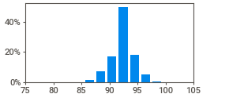
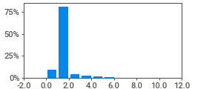
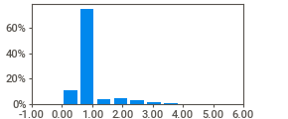
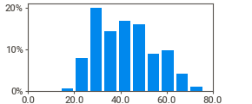
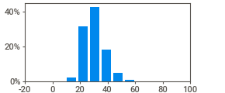
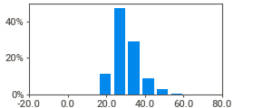
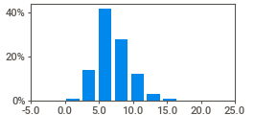
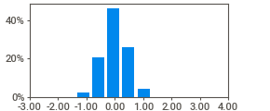
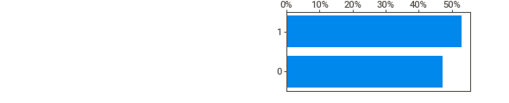
18
spo2_average
37,109 (100%)
---
1,310 (4%)
---
VALUES: MISSING:
DISTINCT: ZEROES:
MAX | 99.5
95% | 95.5
Q3 | 93.3
MEDIAN | 92.3
AVG | 92.2
Q1 | 91.3
5% | 88.6
MIN | 79.5
RANGE | 20.0
IQR | 2.04
STD | 2.02
VAR | 4.07
KURT. | 1.01
SKEW | -0.377
SUM | 3.4M
19
deep_hours
VALUES: | 37,109 (100%)
MISSING: | ---
DISTINCT: | 412 (1%)
MAX | 10.2
95% | 3.0
Q3 | 1.4
AVG | 1.5
MEDIAN | 1.4
Q1 | 1.4
5% | 0.6
RANGE | 10.2
IQR | 0.00
STD | 0.747
VAR | 0.558
 | ZEROES: | 425 (1%)
20 | rem_hours
 | VALUES: MISSING: | 37,109 (100%) ---
 | DISTINCT: | 283 (<1%)
 | ZEROES: | 3,666 (10%)
MIN | 0.0
MAX | 5.53
95% | 2.33
Q3 | 1.07
AVG | 1.11
MEDIAN | 1.07
Q1 | 1.07
5% | 0.00
MIN | 0.00
MAX | 76.0
95% | 64.0
Q3 | 51.0
AVG | 42.1
MEDIAN | 41.0
Q1 | 32.0
5% | 26.0
MIN | 14.0
KURT. | 14.7
SKEW | 3.02
SUM | 57,326
RANGE | 5.53
IQR | 0.00
STD | 0.593
VAR | 0.351
KURT. | 5.61
SKEW | 1.33
SUM | 41,100
21
Age
VALUES: MISSING:
DISTINCT: ZEROES:
37,109 (100%)
---
53 (<1%)
---
RANGE | 62.0
IQR | 19.0
STD | 12.5
VAR | 155
KURT. | -0.790
SKEW | 0.367
SUM | 1.6M
RANGE | 85.0
IQR | 9.50
STD | 7.39
VAR | 54.7
KURT. | 0.721
SKEW | 0.704
SUM | 1.1M
22
ss7dmavg
VALUES: | 37,109 (100%)
MISSING: | ---
DISTINCT: | 752 (2%)
MAX | 86.0
95% | 44.1
Q3 | 34.5
AVG | 30.2
MEDIAN | 29.3
Q1 | 25.0
5% | 19.9
 | ZEROES: | ---
23 | ss28dmavg
 | VALUES: MISSING: | 37,109 (100%) ---
 | DISTINCT: | 4,583 (12%)
 | ZEROES: | ---
24 | ss28dStdev
 | VALUES: MISSING: | 37,109 (100%) ---
 | DISTINCT: | 25,388 (68%)
 | ZEROES: | ---
MIN | 1.0
MAX | 75.0
95% | 43.3
Q3 | 33.8
AVG | 30.2
MEDIAN | 29.3
Q1 | 25.6
5% | 21.0
MIN | 1.0
MAX | 23.7
95% | 11.6
Q3 | 8.6
AVG | 7.1
MEDIAN | 6.8
Q1 | 5.4
5% | 3.7
MIN | 0.0
RANGE | 74.0
IQR | 8.24
STD | 6.64
VAR | 44.0
KURT. | 0.925
SKEW | 0.781
SUM | 1.1M
RANGE | 23.7
IQR | 3.12
STD | 2.47
VAR | 6.09
KURT. | 1.60
SKEW | 0.779
SUM | 264k
25
7D_StdDevfrom28d
VALUES: MISSING:
DISTINCT: ZEROES:
37,109 (100%)
---
35,764 (96%)
1,135 (3%)
MAX | 3.40
95% | 0.73
Q3 | 0.29
AVG | 0.00
MEDIAN | 0.00
Q1 | -0.29
5% | -0.72
MIN | -1.91
RANGE | 5.31
IQR | 0.582
STD | 0.437
VAR | 0.191
KURT. | 0.274
SKEW | 0.093
SUM | 142
26
7Dssma0-1STDev_False
VALUES: 37,109 (100%)
MISSING: ---
DISTINCT: 2 (<1%)
27
7Dssma0-1STDev_True

Slide 27

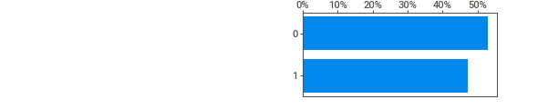
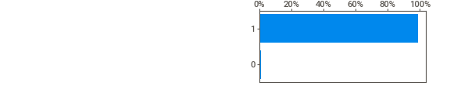
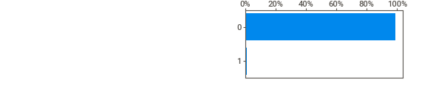


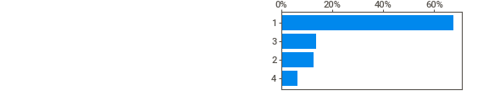
VALUES: 37,109 (100%)
MISSING: ---
DISTINCT: 2 (<1%)
28
7Dssma1-2STDev_False
VALUES: 37,109 (100%)
MISSING: ---
DISTINCT: 2 (<1%)
29
7Dssma1-2STDev_True
VALUES: 37,109 (100%)
MISSING: ---
DISTINCT: 2 (<1%)
30
7Dssma2-3STDev_False
VALUES: 37,109 (100%)
MISSING: ---
DISTINCT: 2 (<1%)
31
7Dssma2-3STDev_True
VALUES: 37,109 (100%)
MISSING: ---
DISTINCT: 2 (<1%)
32
7Dssma3+STDev_False
VALUES: 37,109 (100%)
MISSING: ---
DISTINCT: 2 (<1%)
33
7Dssma3+STDev_True
VALUES: MISSING:
DISTINCT:
37,109 (100%)
---
2 (<1%)
34
Status
VALUES: MISSING:
DISTINCT:
37,109 (100%)
---
4 (<1%)

